Slide 1
BIA-660 Web Mining Introduction

Slide 2
Agenda
Introduction
Name, major, interest, expectation from this course etc.
Syllabus
Course Overview: What is Web Mining?
Python Installation, Jupyter Notebook, Poll Everywhere
Class Survey
Python Review
Pre-Quiz

Slide 3
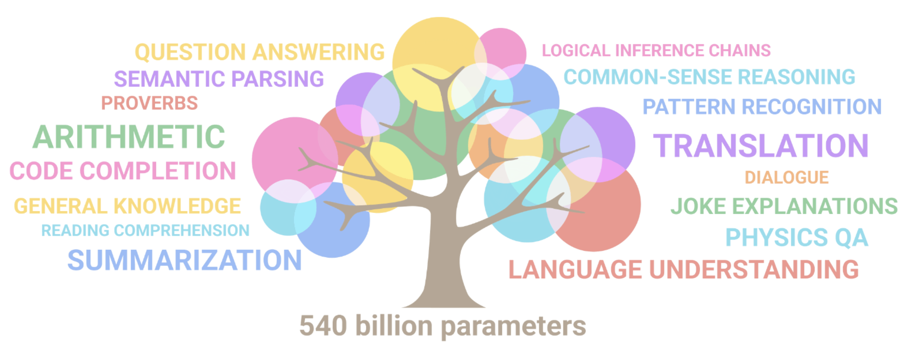
What is Web Mining?
In short, get prepared for large language models (LLMs)
Let’s first understand basics behind LLMs
References:
https://github.com/Hannibal046/Awesome-LLM
https://docs.google.com/presentation/d/1TTyePrw-p_xxUbi3rbmBI3QQpSsTI1btaQuAUvvNc8w/edit#slide=id.g206fa25c94c_0_24
NLP vs. LLMs: https://www.youtube.com/watch?v=FmxcmKvkqnE

Slide 4
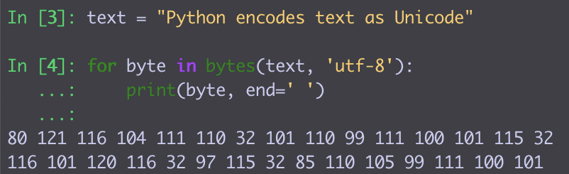
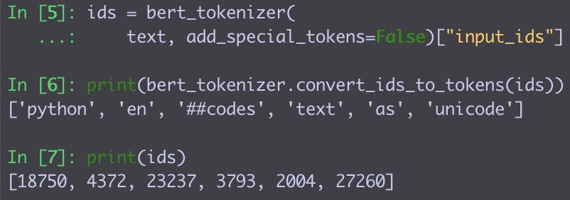
Representing Natural Language in Machines
Strings:
Each character is 1-2 bytes
Great for text manipulations
Concatenate, Find + Replace
No semantics or morphology
Tokens:
Map each word to a token ID
In practice:
Some words are too rare / misspelled
Split these into common word parts and map these to IDs
Tokenization

Slide 5
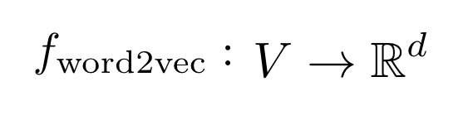
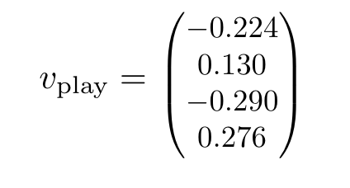
Representing Natural Language in Neural Networks
Word embeddings:
≈ 100–1000 dims!
…..
Models can learn
similar words ≈ similar vectors
in many possible directions.
Embedding

Slide 6
Modeling Natural Language
Language Models: Assign a probability to any sequence of tokens.
e.g. p(dog) > p(turtle)
10⁻⁴ 10⁻⁶
p(a turtle swims in the ocean) > p(a dog swims in the ocean)
10⁻¹¹ 10⁻¹³
Left-to-right language models:
p (a turtle swims in the ocean) = p (a) x
p (turtle | a)
P (swims | a turtle) x
P (in | a turtle swims) x
p (the | a turtle swims in) x
p (ocean | a turtle swims in the)
Models

Slide 7
Text Generation
Sample a token from ~ p(next token | previous tokens)
Append the token to the input
Run the new input through the transformer
… and so on…
[from Alammar, The Illustrated GPT-2, https://jalammar.github.io/illustrated-gpt2/]

Slide 8
Framing tasks as next-token prediction
LLMs are trained to predict the next token.
But how is that useful?
Many tasks conform to next token prediction!
“The plot was substandard, but it left a smile!”
What is the sentiment of above sentence? _________

Slide 9
Framing tasks as next-token prediction
LLMs are trained to predict the next token.
But how is that useful?
Many tasks conform to next token prediction!
“The plot was substandard, but it left a smile!”
What is the sentiment of above sentence? Positive
p(positive | “The plot was substandard, but it left a smile!” What is the sentiment of above sentence? ) = 0.7
p(negative | “The plot was substandard, but it left a smile!” What is the sentiment of above sentence? ) = 0.3

Slide 10
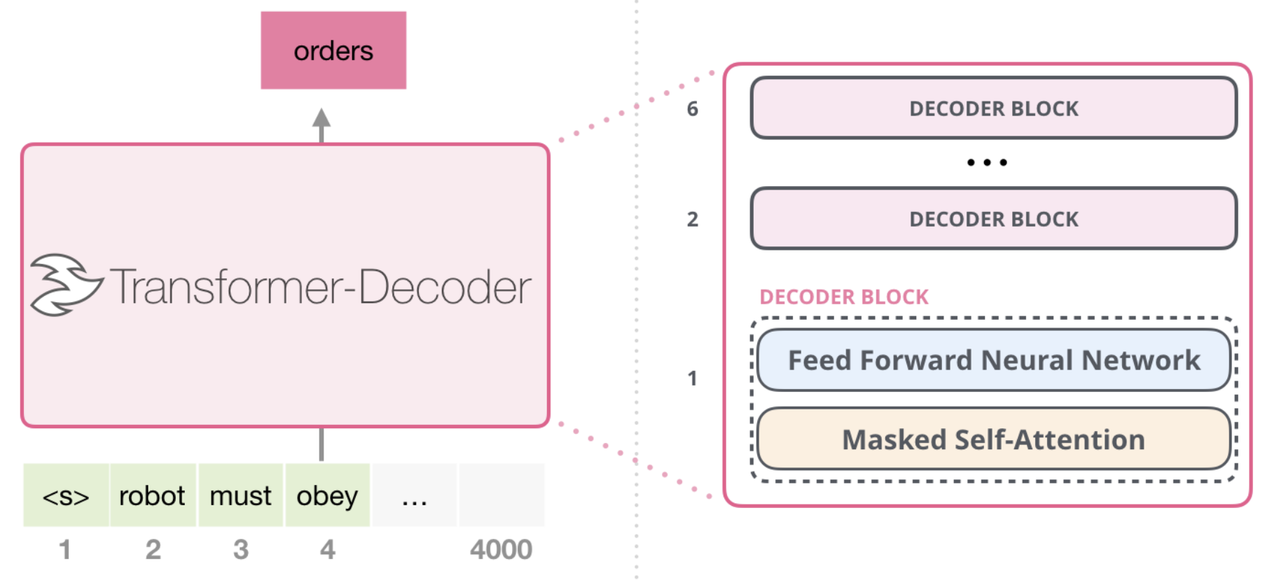
The Transformer Architecture:
How to model p(next token | previous tokens)?
≈ 10–100
layers
[from Alammar, The Illustrated GPT-2, https://jalammar.github.io/illustrated-gpt2/]

Slide 11
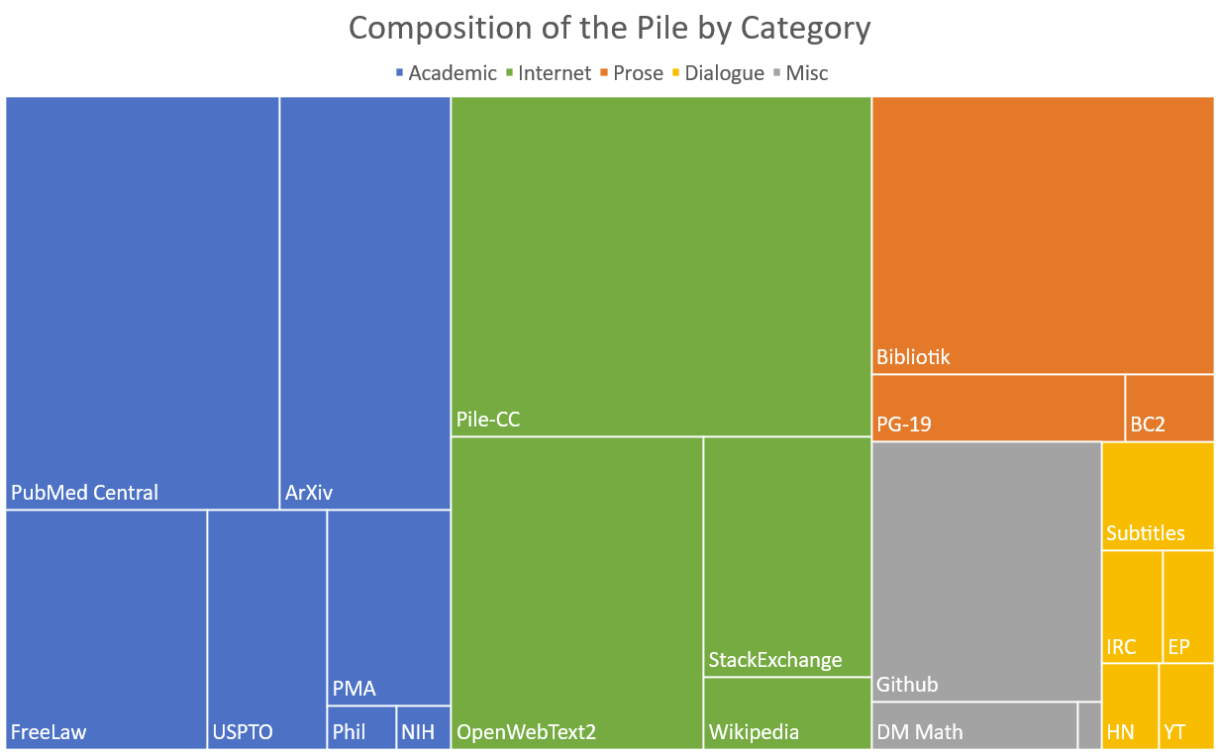
Training a LLM: Data
800GB of open-source data
[from Gao et al., The Pile: An 800GB Dataset of Diverse Text for Language Modeling]

Slide 12







NLP Tasks
Sentiment analysis
Best roast chicken in San Francisco!
Question answering (QA)
The waiter ignored us for 20 minutes.
Spam detection
Coreference resolution
Q. How effective is ibuprofen in reducing fever in patients with acute febrile illness?
✓
Let’s go to Agra!
✗
Paraphrase
A nice gift for you …
Carter told Mubarak he shouldn’t run again.
Word sense disambiguation (WSD)
XYZ acquired ABC yesterday
Part-of-speech (POS) tagging
I need new batteries for my mouse.
ABC has been taken over by XYZ
ADJ ADJ NOUN VERB ADV
Summarization
Colorless green ideas sleep furiously.
Parsing
The Dow Jones is up
Economy is good
I can see Alcatraz from the window!
The S&P500 jumped
Named entity recognition (NER)
Machine translation (MT)
Housing prices rose
PERSON ORG LOC
第13届上海国际电影节开幕…
Dialog
Where is Citizen Kane playing in SF?
Einstein met with UN officials in Princeton
The 13th Shanghai International Film Festival…
Information extraction (IE)
Castro Theatre at 7:30. Do you want a ticket?
You’re invited to our dinner party, Friday May 27 at 8:30
Party May 27 add
Source: Natural Language Processing, Lecture Slides from the 2012 Stanford Coursera course by Dan Jurafsky and Christopher Manning,
http://spark-public.s3.amazonaws.com/nlp/slides/intro.pdf

Slide 13
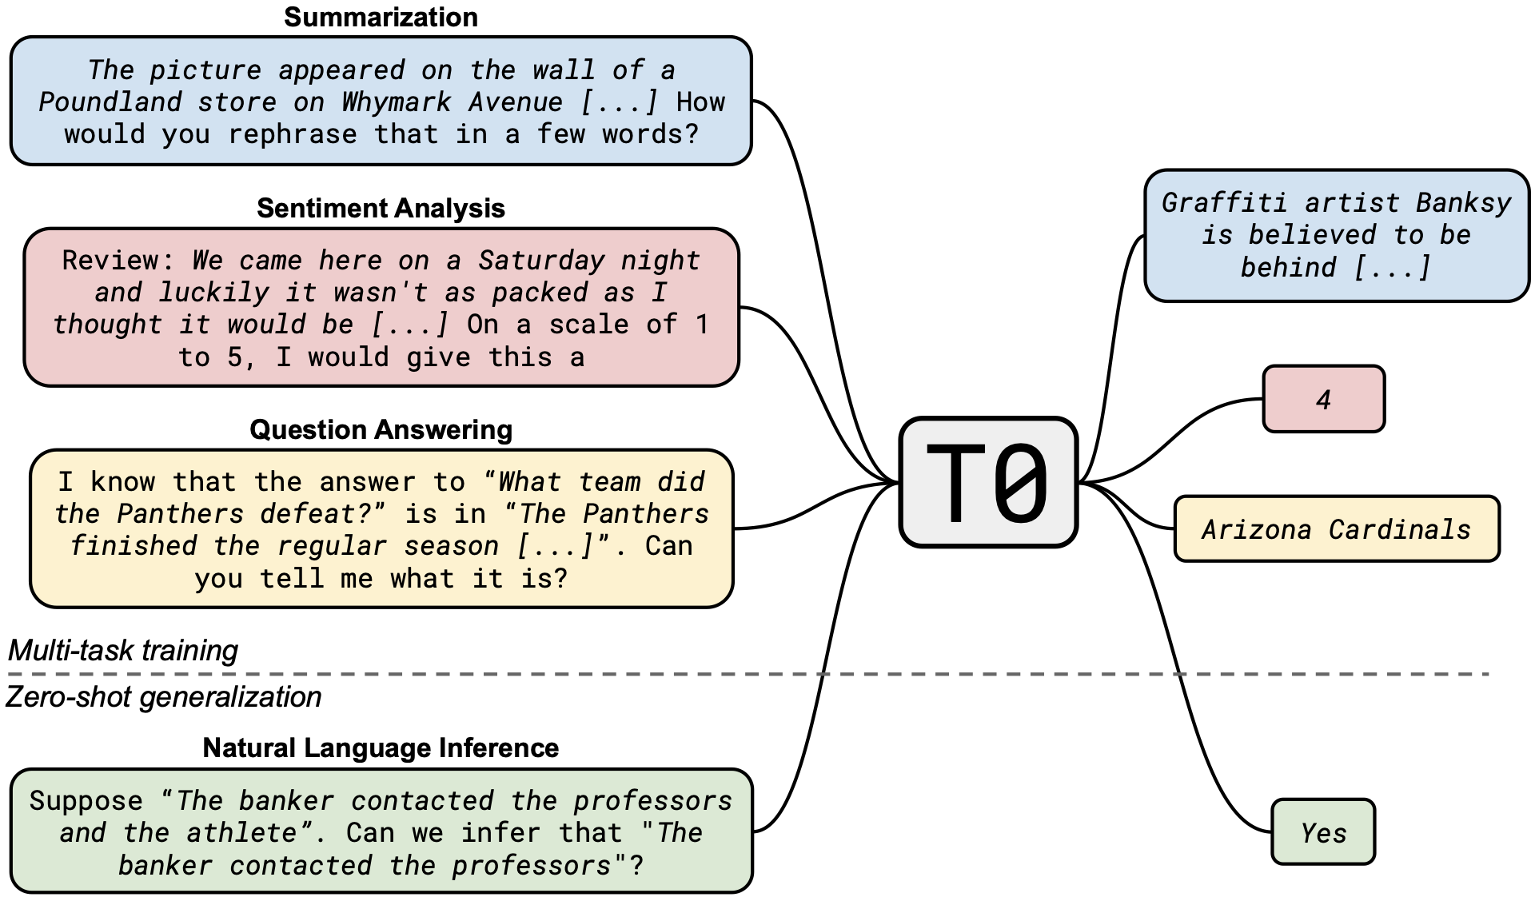
Framing tasks as next-token prediction
Tasks can similarly be framed as next-token prediction.
[Sanh et al., 2022: https://arxiv.org/pdf/2110.08207.pdf]

Slide 14
BIA-66-A Topics Overview
Extract and transform text from html, pdf, doc, xml, txt, …
Scrape static and dynamic web pages
LLM Prompts
1. Collect and clean data
Web Crawling
Extract words/terms (Tokenization)
Part of Speech
Stemming/Lemmatization
Named Entity Recognition
2. Prepare Data for language modeling (Tokenization, Embedding, Semantics Parsing)
Preprocessing / Parsing
Vector Space Model
Word vectors (Embedding)
Feature Extraction
Supervised Learning
Classification
Sentiment mining
Deep learning / LLMs
3. Work on NLP tasks: Classification and Clustering
Text Mining
Unsupervised Learning
Clustering
Topic modeling (LDA)

Slide 15
Syllabus
See Canvas

Slide 16
Python and Python Editor Installation
Recommended: Anaconda. Instruction:
Download Anaconda (prefer Python 3.6 or above version) https://www.anaconda.com/products/individual
Install Anaconda following instruction at https://docs.anaconda.com/anaconda/install/index.html for windows or macOS
After installation, open a terminal (or anaconda command window for Windows) to update python libraries using: conda update --all
Pick Jupyter Notebook as the GUI editor. Launch it from “Anaconda Navigator” or type “jupyter notebook” from terminal (Mac users).
Make sure the following packages have been installed
gensim (4.0.1)
Matplotlib (3.3.2)
Nltk (3.5)
numpy (1.22.3)
Pandas (1.4.0)
spacy (3.0.5)
requests (2.24.0)
beautifulsoup4 (4.9.3)
selenium (3.141.0)
scikit-learn (0.23.2)
Scipy (1.5.2)
Seaborn (0.11.0)
Statsmodels (0.12.0)
Note: The version is for your reference. You may not need to use the exact version

Slide 17
Class Survey
Purpose:
understand the general background of the class
adapt the course materials to the need of the class
Class Survey on Canvas:
5 questions
Response submitted anonymously
Takes less than 5 minutes!

Slide 18
Poll Everywhere
Simple in-class quiz is administered through Poll Everywhere
The quiz results will be counted as your class participation
To participate:
Click “Sign up” at https://www.polleverywhere.com and register using your Stevens Email ID, if you don’t have an account at Poll Everywhere yet
With your account created, now you can login our class poll site: PollEv.com/emilyliu
You should be able to see a test poll (the question is: "Have you used any of the Python Packages below?"). Please respond to this question.

Slide 19
Python Pre-Quiz
The purpose of this quiz is to understand the level of your Python skills so that I can plan the course accordingly
This pre-quiz does not count toward your grades
Sample questions:

Slide 20
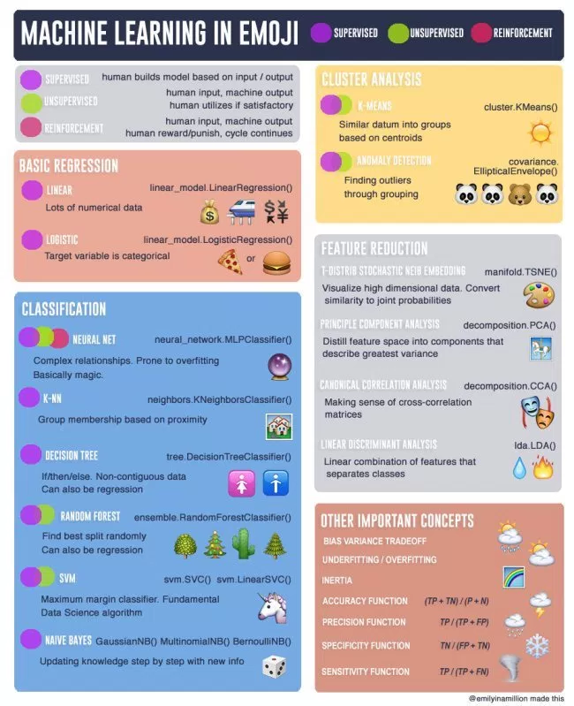
Data Scientist Cheat Sheets
https://blog.makcorps.com/2018/08/cheat-sheets-for-ai-neural-networks.html
Check all of the cheat sheets see how much you know!

